Slide 1

Real-Time Sentiment Analysis
Presented By : Group CrawlOps

Slide 2





group MEMBERS
GOH JIALE
A22EA0043
KOH LI HUI
A22EC0059
MAISARAH RIZAL
A22EC0192
YONG WERN JIE
A22EC0121

Slide 3


Project Overview
Our Goal:
To design and develop a real-time sentiment analysis pipeline for Malaysian-relevant social media/public review data.
Key Objectives:
Collect and preprocess large volumes of text data.
Develop and deploy sentiment classification models.
Implement a scalable system architecture using Apache technologies.
Visualize processed insights through dashboards.

Slide 4





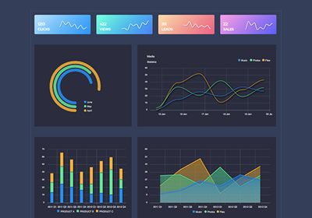

System Architecture
LSTM Model
A script continuously scrapes new comments from Reddit.

Slide 5

Data Collection
We chose Reddit, specifically the r/malaysia subreddit, as a rich source of public opinion.
Website: https://www.reddit.com/r/malaysia/
Source
Utilized the PRAW library for efficient scraping:
Scraped 1000 "hot" posts and all associated comments.
Extracted essential post metadata for comprehensive analysis.
Methodology
Output
Our raw dataset: r_malaysia_comments.csv

Slide 6
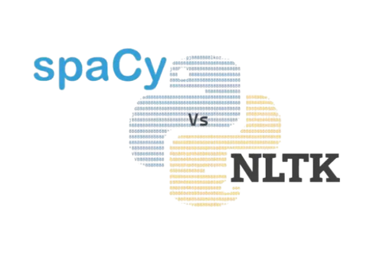

NLP Preprocessing
CHALLENGES
Raw text is inherently noisy and unsuitable for direct machine learning model input.
Elements like URLs, emojis, varied punctuation, and common "filler" words.
Lowercasing: Standardized all text to a uniform lowercase.
URL & Emoji Removal: Eliminated web links and emojis.
Punctuation & Number Removal: Cleaned out non-alphabetic characters.
Tokenization: Broke down continuous text into individual words.
Stopword Removal: Filtered out common, less informative words using NLTK's English stopwords.
Lemmatization: Reduced words to their base form (e.g., "running" to "run").
Solution
Output
Our cleaned dataset: cleaned_r_malaysia_comments.csv
(Ready for subsequent model training)

Slide 7


Sentiment Model Development
Our Approach:
Comparing Two Models
Key Challenge
& Our Strategy
Naive Bayes: A fast and simple baseline model to start with.
LSTM Network: A deep learning model chosen to understand the context and sequence of words.
Challenge: The dataset was highly imbalanced, with most comments being neutral.
Solution: We created initial sentiment labels using Comment Score.
Optimization: We applied Class Weights during LSTM training. This forced the model to pay more attention to the important but rare positive and negative classes.

Slide 8

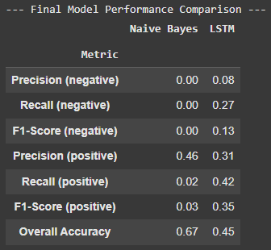

Model Comparison & Results
Key Findings
Naive Bayes Model:
Achieved a misleading 67% accuracy.
Completely failed to identify positive or negative sentiments (F1-Score near 0).
LSTM Model:
Achieved a lower 45% accuracy, but produced far more meaningful results.
Successfully identified comments from all 3 classes thanks to the class weights strategy.
Conclusion
The LSTM Model was the clear winner and selected for our pipeline.

Slide 9
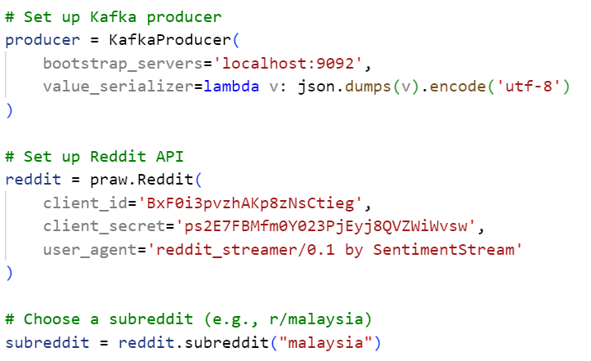
kAFKA + SPARK: Real time processing + STORAGE DATA
KEY Challenges
Maintain data consistency and fault tolerance in a distributed environment.
Ensure minimal latency between Reddit ingestion → processing → storage.
Strategies
Use Kafka for decoupling data ingestion from processing in real time, and use LSTM Deep Learning Model to do sentiment analysis
Use Spark to get real time data from Kafka, and store in Supabase

Slide 10
kAFKA + SPARK: METHODOLOGY
sTEP 1: DATA INGESTION
Use Kafka for real time ingest comment from subreddit “r/malaysia” to local.
Preprocessing data to remove unnecessary and dirty text.
sTEP 3: SPARK
Read real-time Reddit sentiment data from Kafka using defined schema.
Using micro-batch method (every 10 seconds) to collect and insert data into Supabase in real time.
step 2: SENTIMENT ANALYSIS
Use the LSTM Model to get prediction probabilities for all class
Get the predicted class index and its probability, and convert them into sentiment label using mapping.

Slide 11
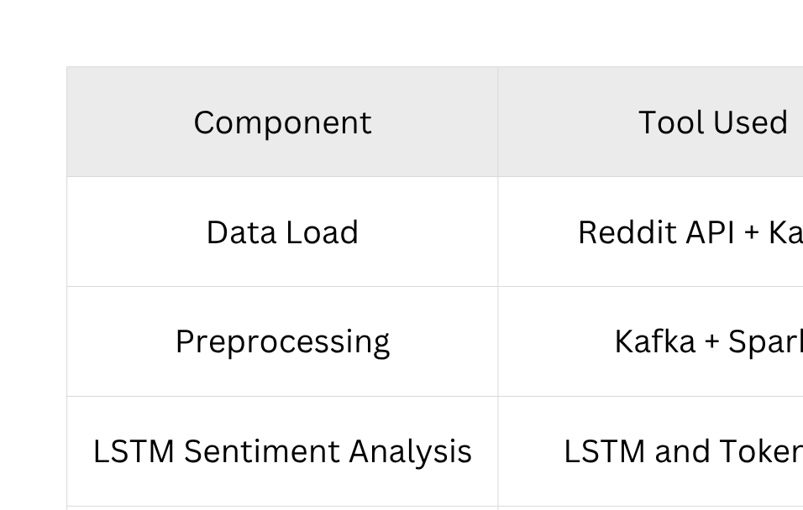
kAFKA + SPARK: conclusion

Slide 12
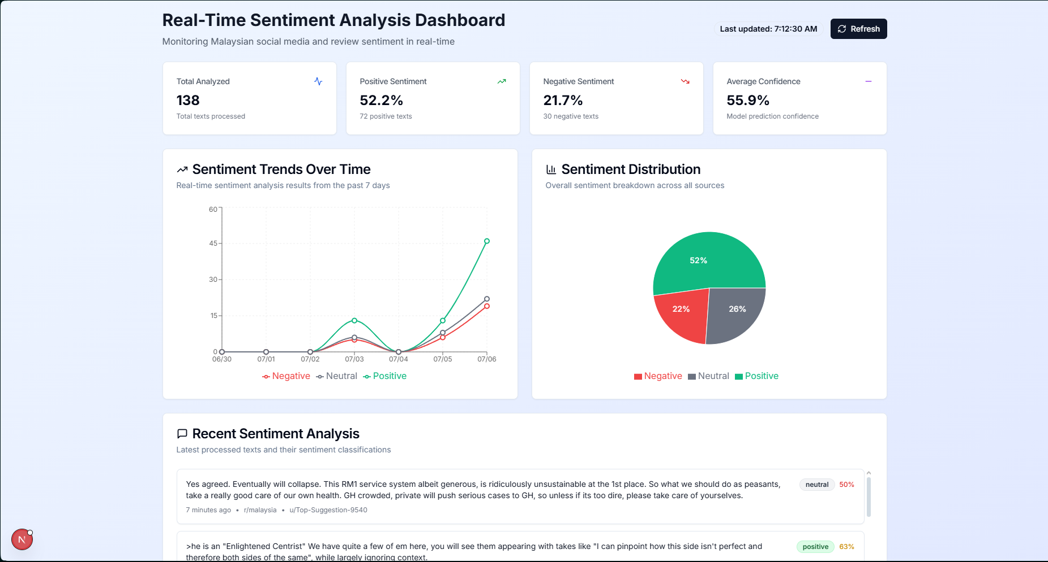
dashboard visualization
Notes:
"The dashboard provides a comprehensive view of real-time sentiment from the r/malaysia subreddit. At the top, key metrics like total analyzed texts, sentiment breakdown, and average confidence give users an instant snapshot.
The line chart tracks sentiment trends over the past seven days, helping spot shifts tied to trending discussions. A pie chart gives a visual summary of overall sentiment distribution.
Finally, the recent sentiment table displays live Reddit posts with their assigned labels and confidence scores—offering transparency and real-world validation of the model’s performance.

Slide 13
dashboard INSIGHTS
Overall Sentiment:
✅ Positive: 51.9%
❌ Negative: 20.8%
⚖️ Neutral: 27.3%
Trend Patterns:
Positive sentiment is rising
Negative sentiment remains mostly flat
Neutral sentiment shows no clear pattern
Model Validation:
Example:
“stay positive” → labeled positive (72% confidence)
Example:
Billing complaint → labeled negative (61% confidence)
Average Confidence:
🎯 55.7% — moderate accuracy, better than random
Notes:
"From analyzing 154 texts, we found that public sentiment is predominantly positive at 51.9%. Negative sentiment accounts for 20.8%, while neutral sentiment makes up 27.3%.
Looking at trends, positive sentiment shows a steady increase, while negative sentiment remains relatively stable.
The model's confidence in its predictions averages around 55.7%, indicating moderate accuracy. Examples like a post labeled 'positive' with 72% confidence show how tone and word choice influence classification.
While the model performs better than chance, improvements can be made through better training data, more advanced models, and deeper contextual understanding."

Slide 14
Conclusion
🎯 Built an end-to-end real-time sentiment analysis pipeline for Malaysian Reddit data.
📌 Focused on r/malaysia subreddit to understand public opinion.
🤖 Compared two models:
🧮 Multinomial Naive Bayes (baseline)
🔥 LSTM (better performance, especially with imbalanced data)
⚙️ Pipeline used:
📦 Apache Kafka : Real-time streaming
🧠 Apache Spark : Distributed processing
☁️ Supabase : Storage & visualization
📊 Delivered real-time insights with a functional dashboard.
Notes:
In conclusion, this project successfully built a complete real-time sentiment analysis pipeline tailored for Malaysian discussions on Reddit. We used the r/malaysia subreddit as our data source and developed a system that can collect, process, analyze, and visualize sentiment in real time.
Two models were trained—Multinomial Naive Bayes and LSTM—with the LSTM performing better, especially in handling imbalanced classes. Our architecture leveraged Apache Kafka for streaming, Spark for distributed processing, and Supabase for storage and visualization.
Overall, we’ve demonstrated a working system that can provide timely insights into public opinion, laying a solid foundation for future enhancements."

Slide 15
FUTURE WORKS
🧠 Improve training data
🌐 Expand data sources
🧬 Enhance model performance
☁️ Optimize infrastructure
📈 Improve dashboard usability
🚨 Integrate monitoring
Notes:
🧠 Improving training data using manual labeling or semi-supervised learning , reducing noise from score-based labels.
🌐 Expanding to other platforms like Twitter/X , Facebook , and local forums for broader insights.
🤖 Enhancing model performance with transformer-based models (e.g., BERT) fine-tuned on Malay or mixed-language text , especially for negative sentiment detection .
☁️ Testing cloud deployment to improve scalability and fault tolerance .
📈 Upgrading the dashboard with interactive filters , historical trends , and real-time alerts for better decision-making in areas like policy evaluation and crisis management .

Slide 16
Thank you

